Slide 1
Analysis & Predictive Modelling for Heart Disease and Stroke Mortality Rates Among U.S. Adults Aged 35+
Aarushi Kotwani Abhishek Namdev Sawant Mustafa Shabbir Bhavanagarwala

Slide 2
Importance of understanding heart disease and stroke mortality rates
Heart disease and stroke are leading causes of mortality globally, contributing significantly to the burden of disease.
Awareness of mortality rates helps quantify the scale of the problem and assess its impact on the overall health of a population.
Knowledge of mortality rates aids in the effective allocation of healthcare resources. It allows for the identification of areas with higher mortality, ensuring that adequate medical facilities and personnel are available to address the specific needs of those regions.
Understanding trends in mortality rates over time facilitates long-term planning. This is essential for anticipating future healthcare needs, developing sustainable healthcare systems, and implementing interventions to address emerging challenges.

Slide 3
Objectives
Analyze variations in heart disease mortality across United States.
Build predictive models for forecasting future mortality rates.
Assist healthcare authorities and policymakers in resource allocation, interventions, and preventive strategies.

Slide 4
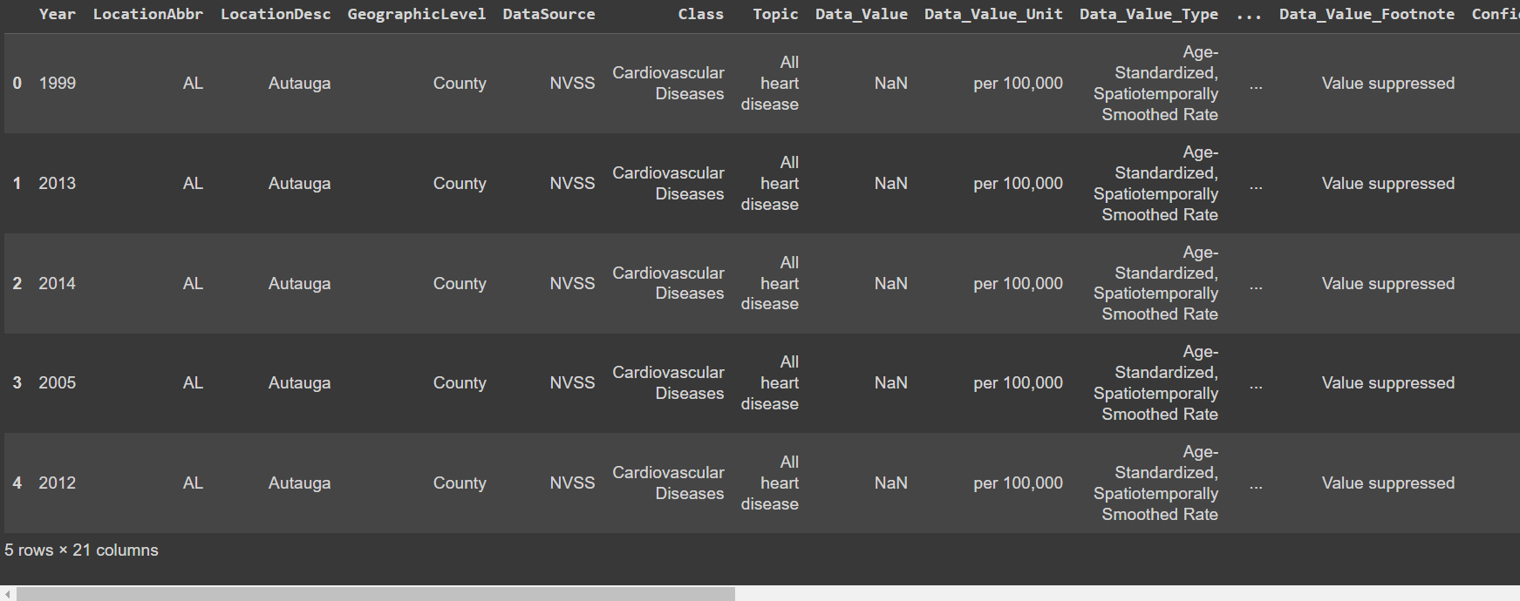
Data Description
Type of data: Mortality data
Size of the data set: 5770240 entries, total 21 columns
Data collection: Data read using a http link

Slide 5
Data Preprocessing

Slide 6
Data Preprocessing
Quality of the data:
The quality of data was unstructured in nature
The data did have missing values and irrelevant columns
Preprocessing of data:
All unwanted columns dropped
Rest columns renamed
Rows corresponding to missing values in variable being predicted are dropped
Duplicate rows dropped

Slide 7
Data Exploration

Slide 8
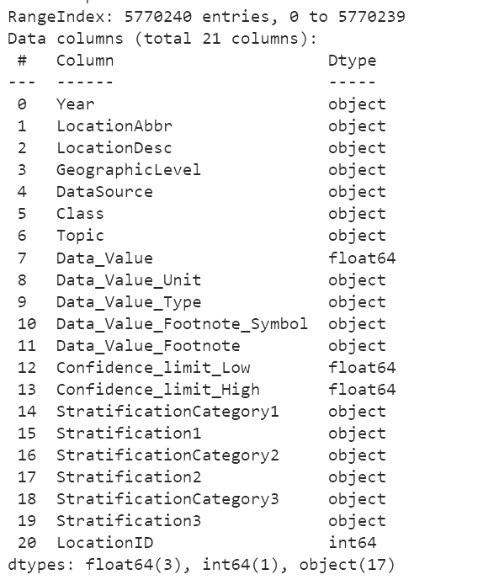
Overview of Original Dataset

Slide 9
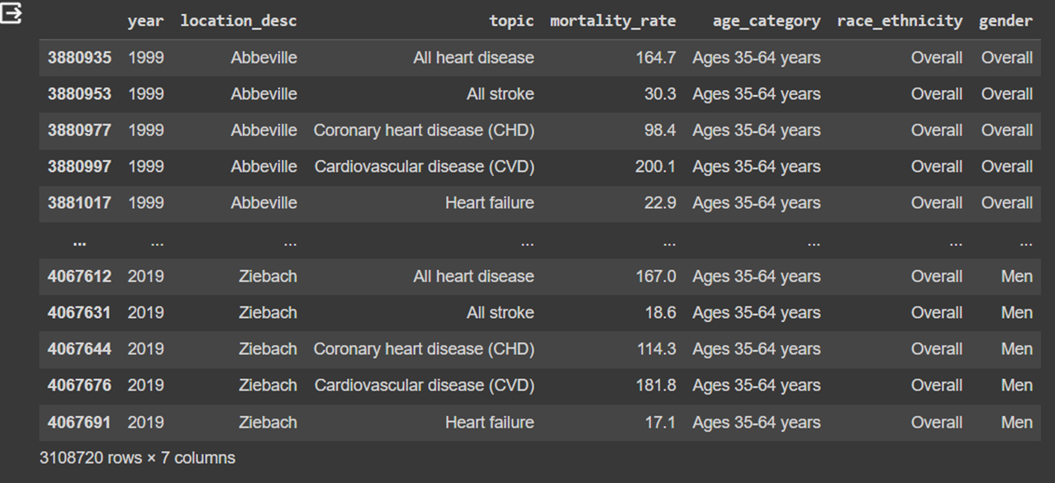
Overview of Dataset after Preprocessing

Slide 10
Exploratory Data Analysis

Slide 11
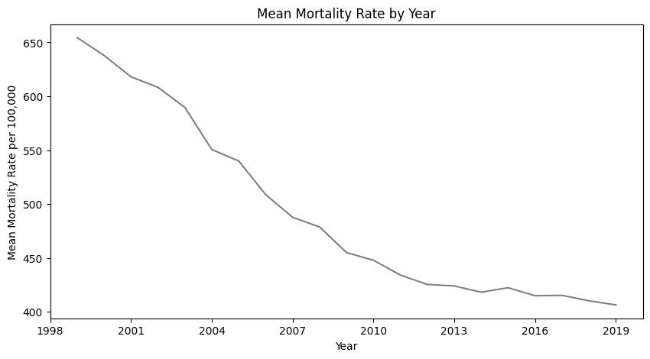
Mortality Rate Year-by-Year

Slide 12
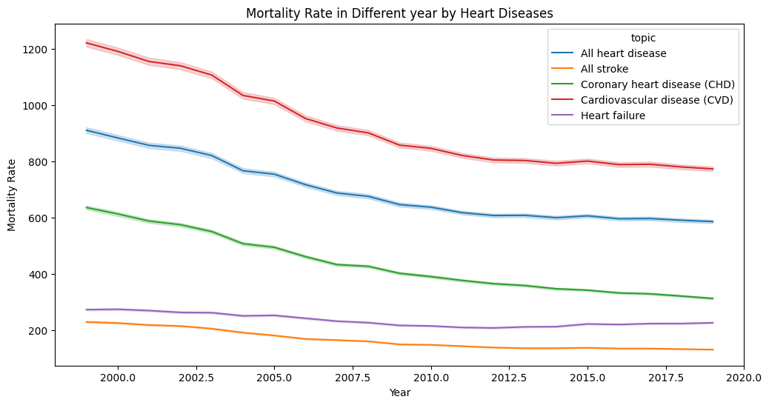
Mortality Rate for Heart Diseases over Years

Slide 13
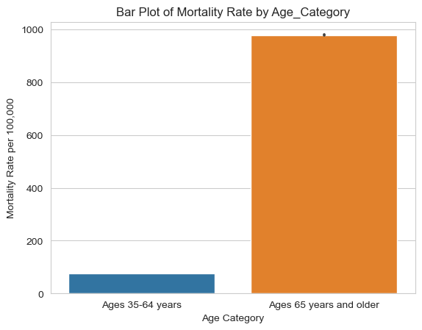
Mortality Rate by Age Groups

Slide 14
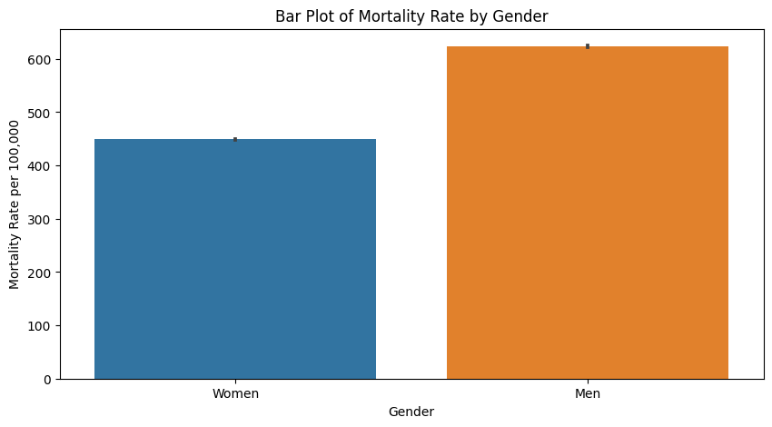
Mortality Rate by Gender

Slide 15
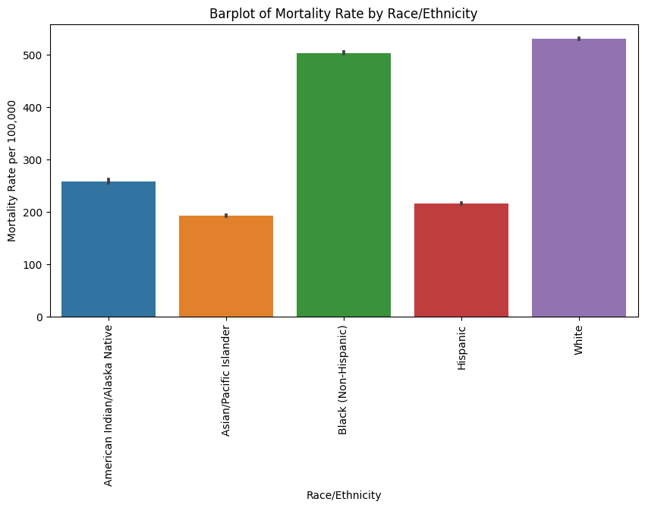
Mortality Rate by Race - Ethnicity

Slide 16
Further Analysis
Type of Problem :-
Supervised Learning :- The training data includes both the input data (features) and output data (labels).
Input Data (Features) - Year, Age Category, Gender, Race - Ethnicity, Topic
Output data: Mortality Rate
Regression based problem :- Mortality rate are numerical values that vary on a scale, making regression model to be well suited.

Slide 17
Modelling
Linear Regression :-
Linear regression is a statistical method used for modeling the relationship between a dependent variable (also known as the outcome or target) and one or more independent variables (also known as predictors or features).
XGBRegressor :-
XGBoost (eXtreme Gradient Boosting) is a popular and powerful machine learning algorithm used for both regression and classification tasks.

Slide 18
Results
Model | Accuracy
Linear Regression | 72.97
XGBRegressor | 93.99

Slide 19
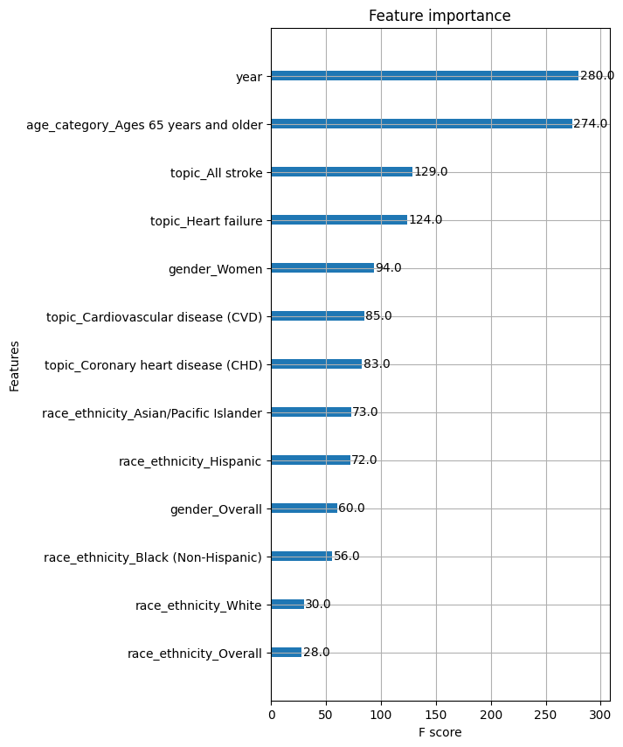
Variable Importance

Slide 20
Conclusion
Through this project we are able to predict the mortality rate based on specific factors.
By doing so, we have a solution to the difficult problem of getting to know about the mortality rate for a specific Year, Topic, also including other factors such as age category, race - ethnicity and gender.
Thus we have analyzed and understood the variations in heart disease mortality data among adults in United States based on various features.
Our solution can help healthcare authorities and policymakers allocate resources, design targeted interventions, and develop preventive strategies to combat these diseases more effectively.

Slide 21


